Slide 1
Recovery Rate from Covid-19 Pandemic:
Comparing Recovery Rate Between the States of Kansas and New Jersey
Notes:
“Five working together to fight data!”
“It’s Morphin’ Time! Dino Charge Ready! Energize! Unleash the Power.”

Slide 2

Data Rangers
Adrian “Python Warrior” Strecker
Cheyenne “Pandas Expert” Parrott
Parijat “Pie Chart” Bhardwaj
Brittney “Bar Chart” Oleniacz
Timothy “Mat Plot” O’Malley
Notes:
*** If we want to add humor we could use names that reference data analytics - e.g. Cheyenne “Pandas Expert” Parrott, Adrian f”(string) Strecker.

Slide 3
Notes:(to be deleted)
We want to start broad with impact of covid and unemployment, get more specific by industry, then conclude by showing the impact to quality of life.
Starting with the question/proposition “Why does NJ have a higher recovery rate?”
We are going to Introduce the issue of covid using quotes and headlines.[timothy/brittney]
We are going to propose that NJ has been more effective at “recovering” [timothy/brittney]
We will show quick facts about the states side by side [parijat]
We are going to show the facts/data/graph of the number of cases by state(cum/daily)[Adrian’s slides]
We are going to show the data in unemployment/employment/unemployment rates (by NJ/KS when we can, otherwise national) [use slides from Cheyenne, Parijat]
We will show how separate industries were impacted more than others. - nationwide data(it looks like service industry) . . . . > are we still using this info, how does this fit our proposition?
We are going to speak to/show data for/propose what NJ is doing to raise the recovery rate. [use info from Brittney and the CPD (using the data to show how NJ has impacted the other areas of life/quality of life that are a fallout of the economy being impacted. [Brittney to use 3 or 4 slides]
Provide recommendations based on the data - what KS could do
Sporactic testing(KS)look at the data - why are there some days wtih low testing
4. What we say ks could diff

Slide 4
Introduction (to be deleted)
Visual aid: quotes from the news….over dramatized
“ ‘The coronavirus has crystallized in the minds of more people the absolute divisions between socioeconomic groups and between races,’ former Kansas City Mayor Sly James - timothy
“Low gasoline prices don’t do much for you if schools are closed, you cancel your trip or you’re working from home because of the virus.” — Daniel Yergin, an energy historian and vice chairman of IHS
Why we chose this topic. -see economic impact of covid
Why did we pick Kansas and New Jersey?
Population, location, timing, deaths, differences in industry, etc.
Notes:
We see it in the papers, social media, we hear it in the news…”The COVID economy” The impact of COVID”, but what is the impact?”

Slide 5
Covid-19 Has Had a Major Impact on the Economy
Covid-19 has been, and continues to be, the defining issue of 2020; it has caused major disruption for almost any area of life, including on the nation’s economy and labor market.
“The coronavirus has crystallized in the minds of more people the absolute divisions between socioeconomic groups and between races.” — Sly James, former Kansas City Mayor
“Low gasoline prices don’t do much for you if schools are closed, you cancel your trip or you’re working from home because of the virus.” — Daniel Yergin, an energy historian and vice chairman of IHS

Slide 6
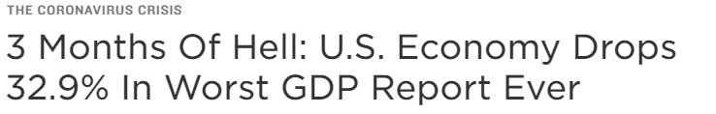
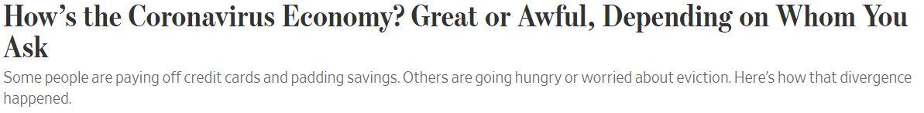

Covid-19 in the Headlines:

Slide 7
Kansas vs New Jersey
Our team wanted to know if there were any trends or conclusions we could find regarding states’ responses to the pandemic.
Specifically, we chose the data from two different U.S. states to compare and contrast the impact and response of the virus.
We chose to analyze the data from Kansas and New Jersey because of differences in such as geography, population density, industries, etc.

Slide 8
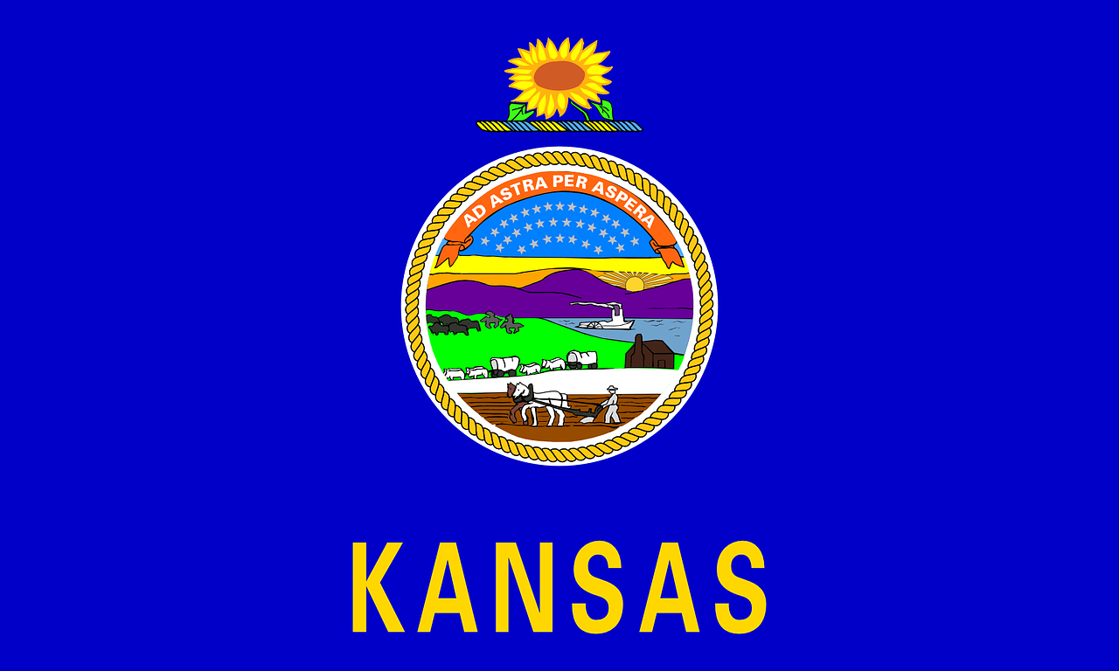

Demographics
Kansas
Total Population - 2,908,776
Total Households - 1,124,549
Median Age - 36.5
Total Employer Establishment - 74,947
Population per square mile - 35.6
Population above 65 - 15.1%
New Jersey
Total Population - 8,881,845
Total Households - 3,213,362
Median Age - 39.8
Total Employer Establishment - 233,907
Population per square mile - 1,215
Population above 65 - 15.5%

Slide 9
Assumptions
The impact of the Covid-19 virus would be significantly worse in New Jersey than in Kansas by studying:
The number of cases of COVID
Unemployment factors
Impact of unemployment
Trends could be discovered regarding unemployment by industry.

Slide 10
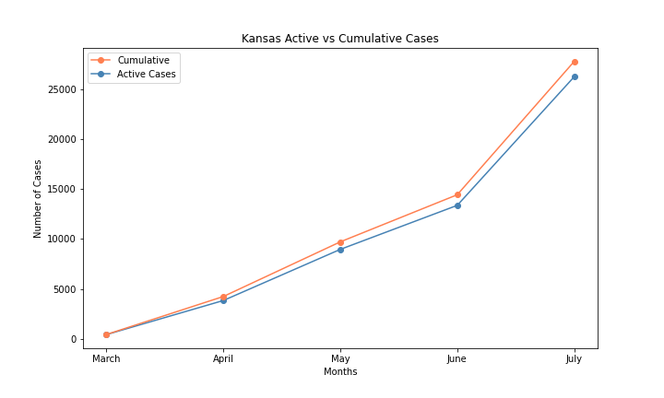
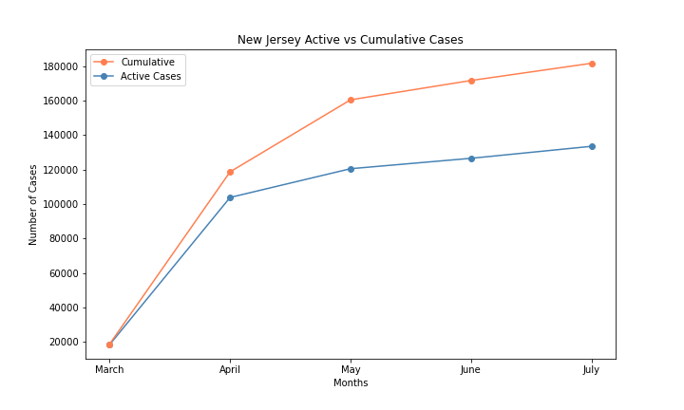
Covid Tracking Reporting: Active Cases vs Cumulative by Number
Despite a smaller population density, Kansas has NOT flattened the curve to reduce the spread to a stable level as of July. New Jersey appears closer to ‘flattening the curve’ if not already at this time.
** Sources: https://api.covidtracking.com (data collection) & JHU - https://github.com/CSSEGISandData/COVID-19/tree/master/csse_covid_19_data (referenced for calculation accuracy)
Notes:
NJ has made testing far more accessible by offering a search for testing sites and informing citizens about asymptomatic cases: https://covid19.nj.gov/pages/testing KS appears to be less open to testing without symptoms: https://www.coronavirus.kdheks.gov/280/COVID-19-Testing (this could be due to New Jersey being close to New York when they were the epicenter which prompted firmer action taken to reduce the spread (e.g.: stricter measures such as assisting the medical community, mandating self-quarantine for travelers, and mask usage mandates enacted earlier than Kansas))

Slide 11
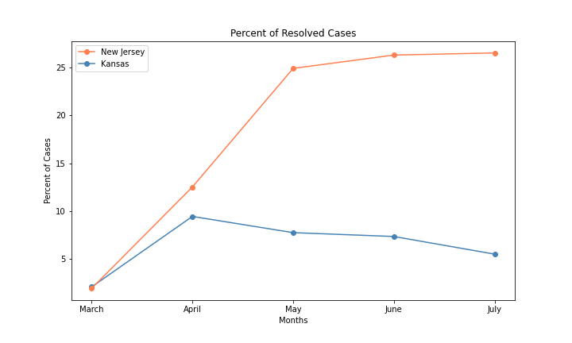
Percent of Resolved Cases by State
New Jersey has a much higher rate of resolved case which means fewer active cases in relation to cumulative cases.
** Sources: https://api.covidtracking.com (data collection) & JHU - https://github.com/CSSEGISandData/COVID-19/tree/master/csse_covid_19_data (referenced for calculation accuracy). JHU for policy timing: https://coronavirus.jhu.edu/data/state-timeline/new-confirmed-cases/new-jersey/
Notes:
Is this reflective of more truly recovered cases or is there a higher death rate resulting in more ‘resolved’ cases? This appears to correlate with the high number of measures put in place to reduce the spread including, but not limited to, closing parks, reinstating medical licenses for further medical assistance, providing shelters for those who could not self isolate, and more. In contrast, Kansas has had a much more lax approach in comparison with far fewer policies put in place as the virus spreads. Another factor to consider is death rate which is a factor of considering a case as ‘resolved’.

Slide 12
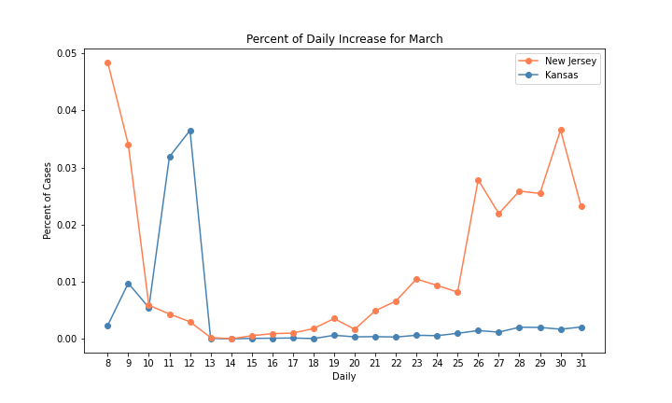
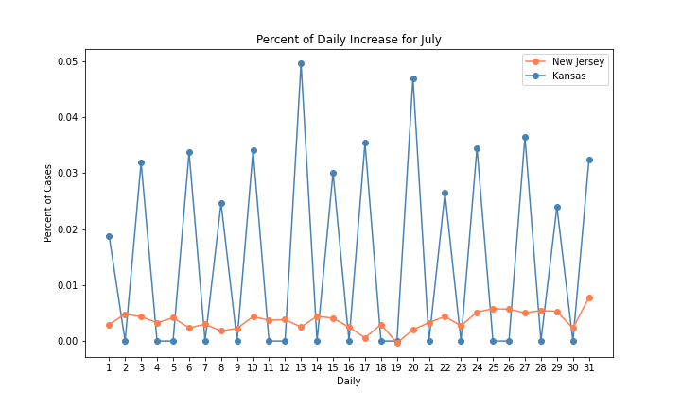
Percent Daily Increase for March & July
Between March and July, there is a vast difference in cases between the two states. Testing was hard to come by in March and was therefore prioritized in the states considered to be higher risk. This is most likely why we initially see New Jersey with far more reported cases than Kansas while the latter had a spike before appearing to stabilize. Fast forward to July and we see New Jersey reporting far more stable numbers than Kansas.
** Sources for more testing insight - New Jersey: https://covid19.nj.gov/pages/testing Kansas: https://www.coronavirus.kdheks.gov/280/COVID-19-Testing
Notes:
This could be due not only to policy differences between the states but the mentality of two different populations as well (after all, you would think a smaller and less densely populated state would be safer, right?)

Slide 13
Factors to Consider
Kansas
Total Tests performed 674,350
Percent Positive Range 6 - 10%
Test rate per 100,000 - 23,161
New Jersey
Total Tests performed 2,515,101
Percent Positive Range 0-5%
Test rate per 100,000 - 28,232
Notes:
What is the time range here? Or is it just overall?
Per 100,000 what?

Slide 14
[Some more] Factors to Consider
Kansas
1,124,549 households
12.4% of households had income below the poverty level in the past 12 months
62.7% of them have incomes less than $75,000 annually.
Weekly Average Delay in medical care 37.5%
On an average 40% household have experienced some loss in income
Percent of uninsured 8.8%
On an average counties in Kansas have 46% of residents with 1-2 risk factors and 24% with 3+ risk factors
New Jersey
3,213,362 households
10.4% of households in this area had income in the past 12 months below the poverty level
47.7% of households have incomes less than $75,000 annually.
Weekly Average Delay in medical care 44.0%
On an average 53% household have experienced some loss in income
Percent of uninsured 7.4%
On an average counties in New Jersey have 51% of residents with 1-2 risk factors and 25% with 3+ risk factors
Notes:
^can you define risk factors?
(source https://covid19.census.gov/)
(source https://public.tableau.com/views/CommunityResilienceEstimates/story?:showVizHome=no)
(source https://www.census.gov/data-tools/demo/hhp/#/?measures=CDR&s_state=00020,00034)
https://www.census.gov/content/dam/Census/library/publications/2019/demo/p60-267.pdf page 25
Additional Source https://covidtracking.com/race/dashboard

Slide 15
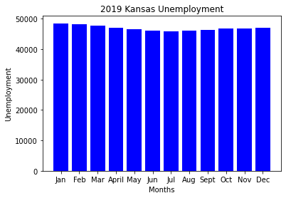
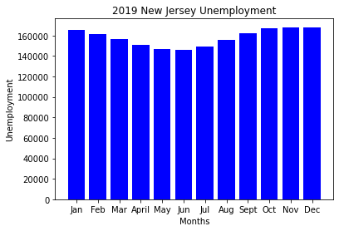
Unemployment Before Covid-19 (FY 2019)
Source: U.S. Bureau of Labor Statistics (https://www.bls.gov/data/#unemployment)
During 2019, Unemployment in Kansas and New Jersey remained steady throughout the fiscal year, with no drastic changes other than seasonal changes.

Slide 16
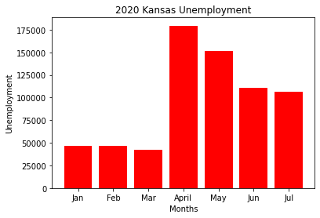
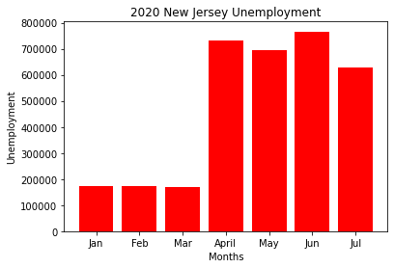
Unemployment During Covid-19 (FY 2020)
Source: U.S. Bureau of Labor Statistics (https://www.bls.gov/data/#unemployment)
However, during the COVID-19 pandemic, between the months of March - July, Unemployment in both states skyrocketed beyond normal seasonal averages. In NJ, unemployment jumped to 16.3% between March and April. In KS, unemployment increased to 11.9%.

Slide 17
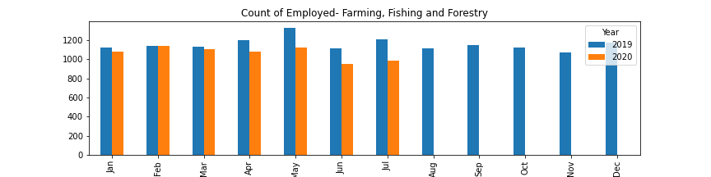
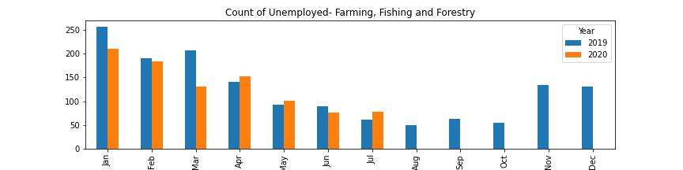
Farming Fishing and Forestry (we discussed removing)

Slide 18
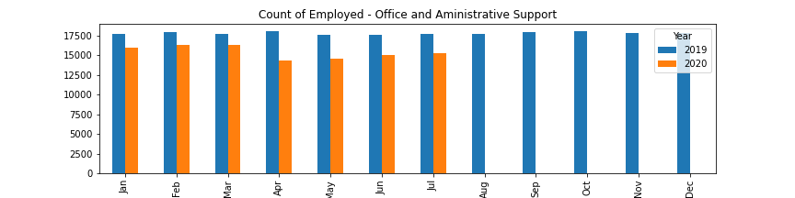
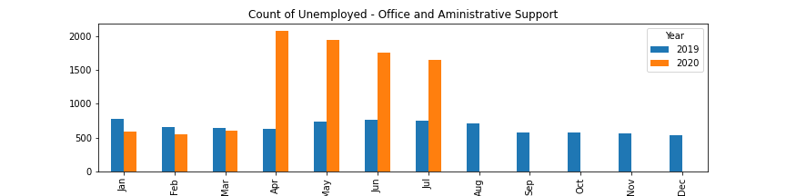
Office and Administrative (we discussed removing)

Slide 19
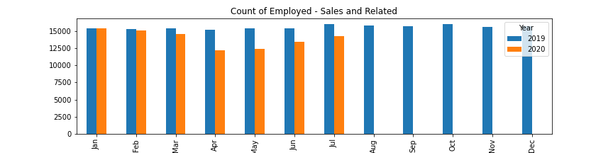
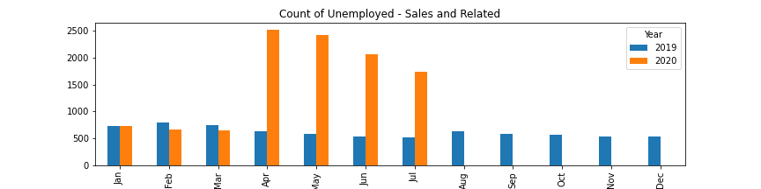
Sales and Related (we discussed removing)

Slide 20
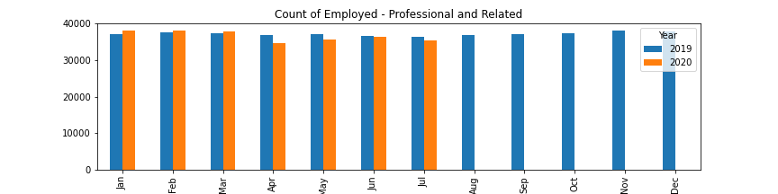
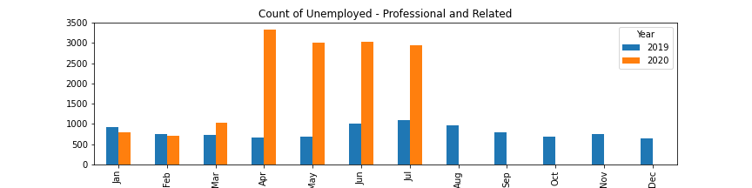
Professional and Related (we discussed removing)

Slide 21
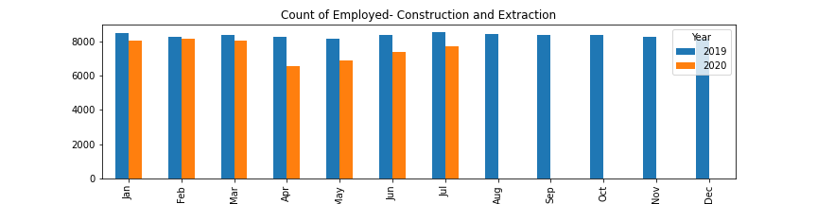
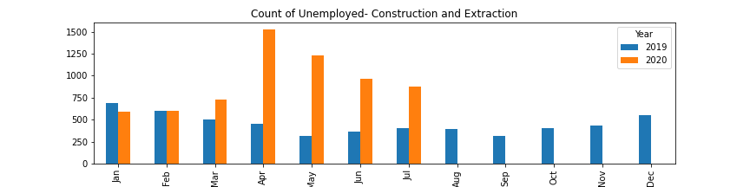
Construction and Extraction (we discussed removing)

Slide 22
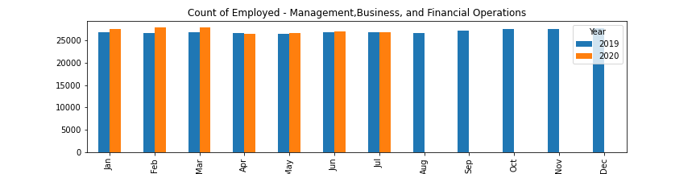
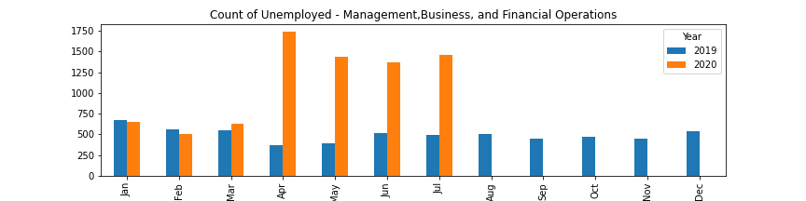
Management, Business and Financial (we discussed removing)

Slide 23
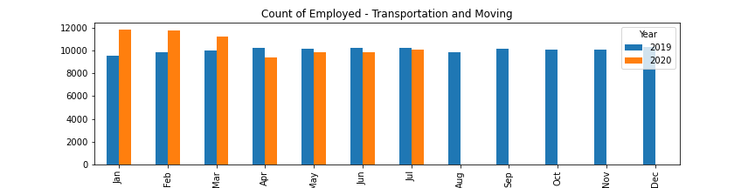
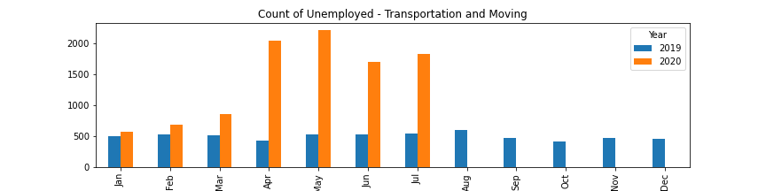
Transportation and Moving (we discussed removing)

Slide 24
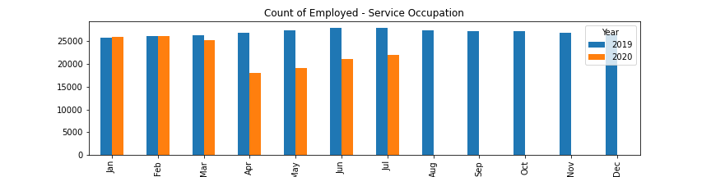
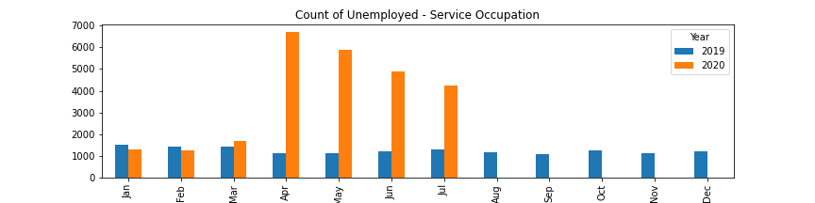
Service and Related (we discussed removing)

Slide 25
Industry unemployment impact on lifestyle (to be deleted)
i.e. education industry taking a larger hit in NJ…..and PULSE showing change in education is higher in NJ. How much does an industry we may not think of impact our lives? (Gettin’ philosophical up in herr’!

Slide 26
General notes/things to consider (to be deleted)
We have to cite where we got the data from!
What we expected vs. unexpected results.
Likely causes for data anomalies
Overall conclusions
Which state is handling COVID better?
What industry needs/deserves the most help?

Slide 27
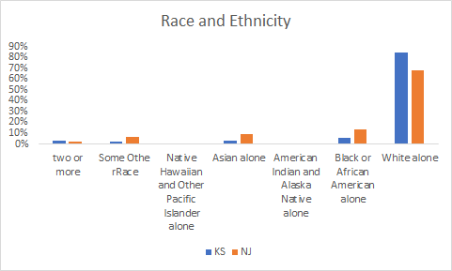
Factors to consider (Better title) (why Kansas may not be there?)
Will make this graph in jupyter notebook Race and ethnicity are risk markers for underlying conditions that impact health - including socioeconomic status, access to healthcare, and increased exposure to the virus due to occupation(e.g., frontline, essential and critical infrastructure workers)
Notes:
I will make this in jupyter notebook ...wanted to add one before our discussion

Slide 28
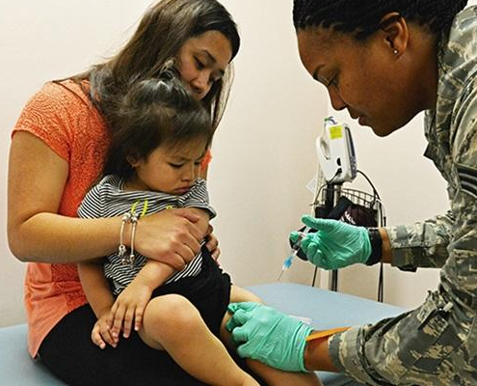
Impact on Key Areas of Life
“The Household Pulse Survey will ask individuals about their
experiences in terms of employment status, spending patterns,
food security, housing, physical and mental health, access to health care, and educational disruption.”
Notes:
Despite the differences between Kansas and New Jersey, and both states experiencing increases in unemployment, the resp
Community resilience estimate is how individual counties are impacted by local disasters and wasn’t built for something as broad as a pandemic.
The the Census Bureau collaborated with other federal agencies to produce data on the social and economic effects of COVID on american households and designed to be longitudinal tol provide insights on how household experiences changed during the pandemic. Designed to be a 12-week survey, from April 23rd to July 2nd and serve as a short-turnaround instrument that would provide valuable data to aid in the post-pandemic recovery, focusing on the the respondent experience of employment loss.

Slide 29
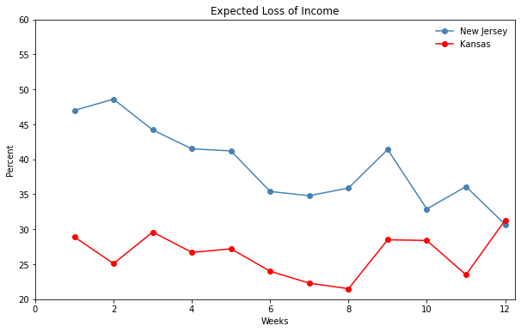
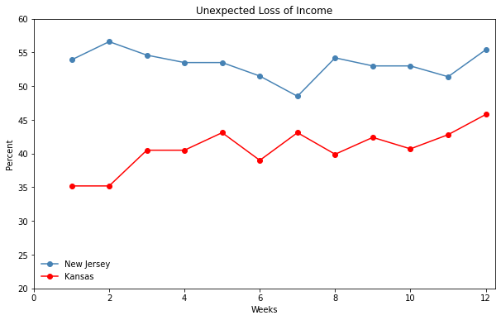
Loss of Income
Percentage of adults who expect someone in their household to have a loss in employment income in the next 4 weeks.
Percentage of adults who unexpectedly loss their primary source of income in the last 7 days.
Notes:
Focus on the respondent experience of work, and for those who did not work in the last seven days, and the reasons for not working related to COVID.
Despite, more NJ survey takers expected a loss of income than KS participants and the trends are closely parallel from week 4 to week 9, and then become inversely related as NJ decreases and and KS has the largest increase. The unexpected loss of income has been relatively flat, while it continues to increase.

Slide 30
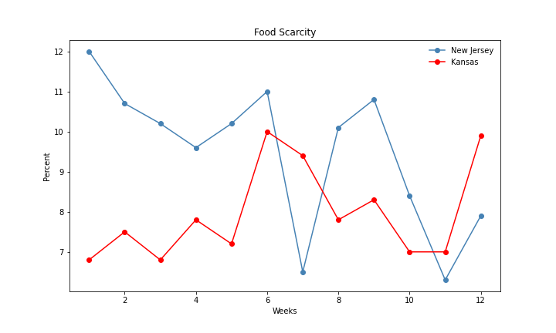
Food Scarcity
Measures food sufficiency and security, asking food sufficiency for the period prior to March 13th, 2020 in addition to the last seven days and the confidence of being able to afford food over the next four weeks.
Notes:
Losses in employment income, along with disruptions in other parts of the economy, have led to significant efforts to provide food in many communities. measures food sufficiency and security, asking food sufficiency for the period prior to March 13th, 2020 in addition to the last seven days. The trend starts with a inverse relationship. We observe an increase in both states from week 4 to 6, and then I’m not entirely sure what happened in mid-june from week 6 to week 8. In the last week we see a greater percentage of kansan were experiencing food insecurity. While there’s fluctuation, the general trend is

Slide 31
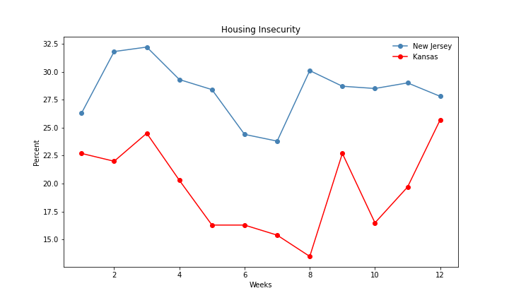
Housing Insecurity
# of Renters
KS: 871,031
NJ: 2,924,825
Eviction Lab Score
KS: 0.85/5.00
NJ: 2.08/5.00
Percentage of adults who are not current on rent or mortgage payments, or who have slight or no confidence that their household can pay next month’s rent or mortgage on time.
Notes:
Again, we start along the same trend, but it begins to differ around the 9th week.
Overall, the percentage of insecure households is lower in kansas than in New Jersey. But, when considering the policies surrounding housing insecurity in Kansas, the state scored a [point eight five] out of five! Meanwhile, NJ has a higher percentage of insecure households, but received a [two point zero eight] out of five. These relationships can be explained by the differences in the state wide policies because both states approached this subject differently and focuses on different areas of the issues. The Kansas policy looks at just the present, no eviction notices, but doesn’t ensure stability in the future. New Jersey, on the other hand, is allowing eviction notices to be filed, with nearly 20,000 notices filed since April, but the eviction process stops there and can’t progress until 60 days after the CDC concludes the pandemic and seeing as COVID-19 continues to rage on, that won't be anytime soon.
Much like the COVID testing and treating, it appears New Jersey is more stable and has been more proactive, while Kansas is unstable and will continue to fluctuate, and merely reacting to issues and concerns.
https://evictionlab.org/covid-policy-scorecard/

Slide 32
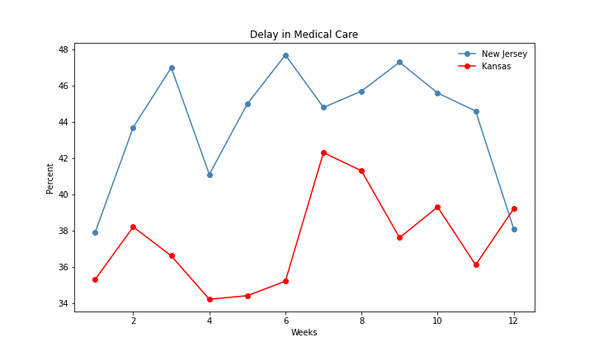
Delay in Medical Attention
Notes:
Intended to measure aspects of mental health and general health status of households and address the delayed and forgone medical care as a result of the COVID-19 pandemic.
This correlates to the earlier graphs of cases of COVID. As we NJ start to flatten the curve, the pressure on the healthcare system is lifted, allowing less of delay in medical attentions. But, because covid rages on in KS, we are still seeing a lot fluctuation. However, KS, continues to fluctuate.

Slide 33

Conclusions
Despite a higher population and greater population density, it appears New Jersey has been more successful than Kansas at managing the spread of Covid-19.
This is likely based on factors such as access to medical care addressing food insecurity.
New Jersey had a greater increase in unemployment, most likely due to a larger service/retail industry.
Despite the greater increase in unemployment, the respondent impact of loss of unemployment to New Jersey households was generally less than that of Kansas.
This was a surprise as we assumed New Jersey would be
worse off than Kansas.

Slide 34
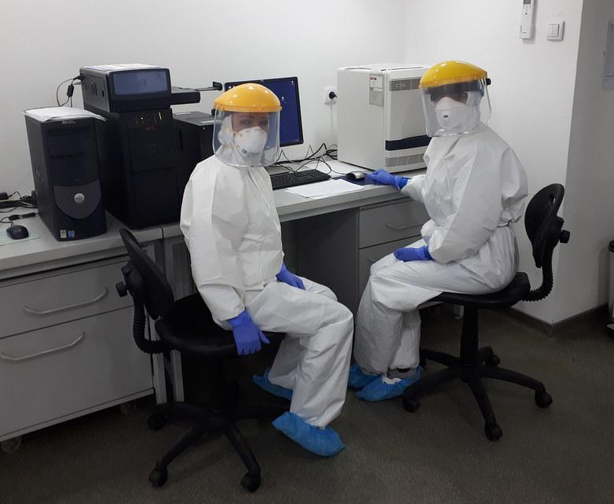
Implications
Suggestions for Kansas:
more consistent testing
extend housing freeze to post-eviction notice processes
better education on how the virus spreads
stricter measures such as assisting the medical community and mandating self-quarantine for travelers

Slide 35

Finishing Thoughts . . .
This was a complex issue and it was difficult to focus on our comparison between New Jersey and Kansas.
Also it was difficult to get data on specific industries for each state as most data tended to be nationwide.
The Covid-19 pandemic is ongoing and constantly changing. The current data trends presented here may not be reflected in
future analyses.
Notes:
Phase II of the PULSE survey has started and asks more specific questions based on the data from Phase I.

